Slide 1

Four Prayers for the Ending of the Year
Psalm 90
Notes:
Psalm 90 informs us that life is short, our distresses are great, and God’s work and His glory should occupy our lives. May our prayers ever be for His wisdom to guide us, His mercy to help us, and His work to occupy us for whatever days of our lives remain.

Slide 2
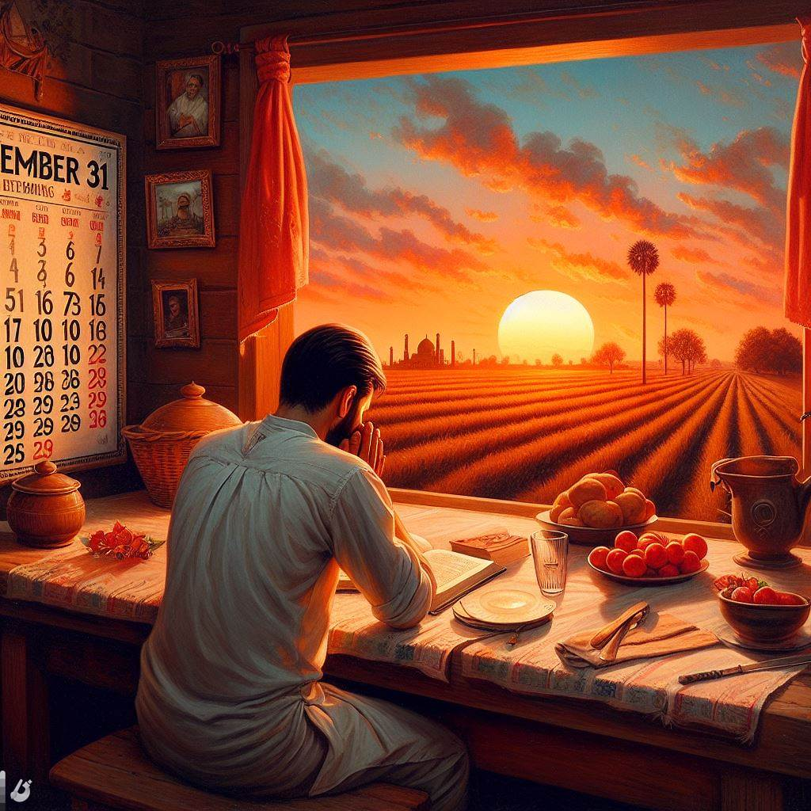
Give us wisdom to make our days count -- Psalm 90:12
We need God’s wisdom (1 Corinthians 1:25).
We should seek true wisdom above all else (Proverbs 4:5-7; 16:16).
Wisdom reveals itself in application (James 3:13-17).
Wisdom brings peace and life (Proverbs 3:17-18; 11:30; 13:12; 15:4; Ecclesiastes 7:12)

Slide 3
Have compassion and mercy on us -- Psalm 90:13-15
Our Need for Mercy is displayed throughout the Psalms.
In distress and sickness (Psalms 4:1; 6:2; 31:9).
From the oppression of the wicked (Psalms 9:13; 30:10; 86:16-17; 123:3).
From the guilt of sin (Psalms 51:1; 31:9-10).
Note Psalm 25.

Slide 4
show us the work we are to do -- Psalm 90:16
There is a lot of work to do, and we were created in Christ to do it (Ephesians 2:10; 1 Corinthians 15:58).
We should pray for opportunities to do God’s work (Colossians 4:3).

Slide 5
Empower us to do Your work -- Psalm 90:17
It should be our constant prayer for the Lord to strengthen us to accomplish the work He has for us to do (Ephesians 3:20; Philippians 3:13; 1 Peter 4:11).

